Slide 1




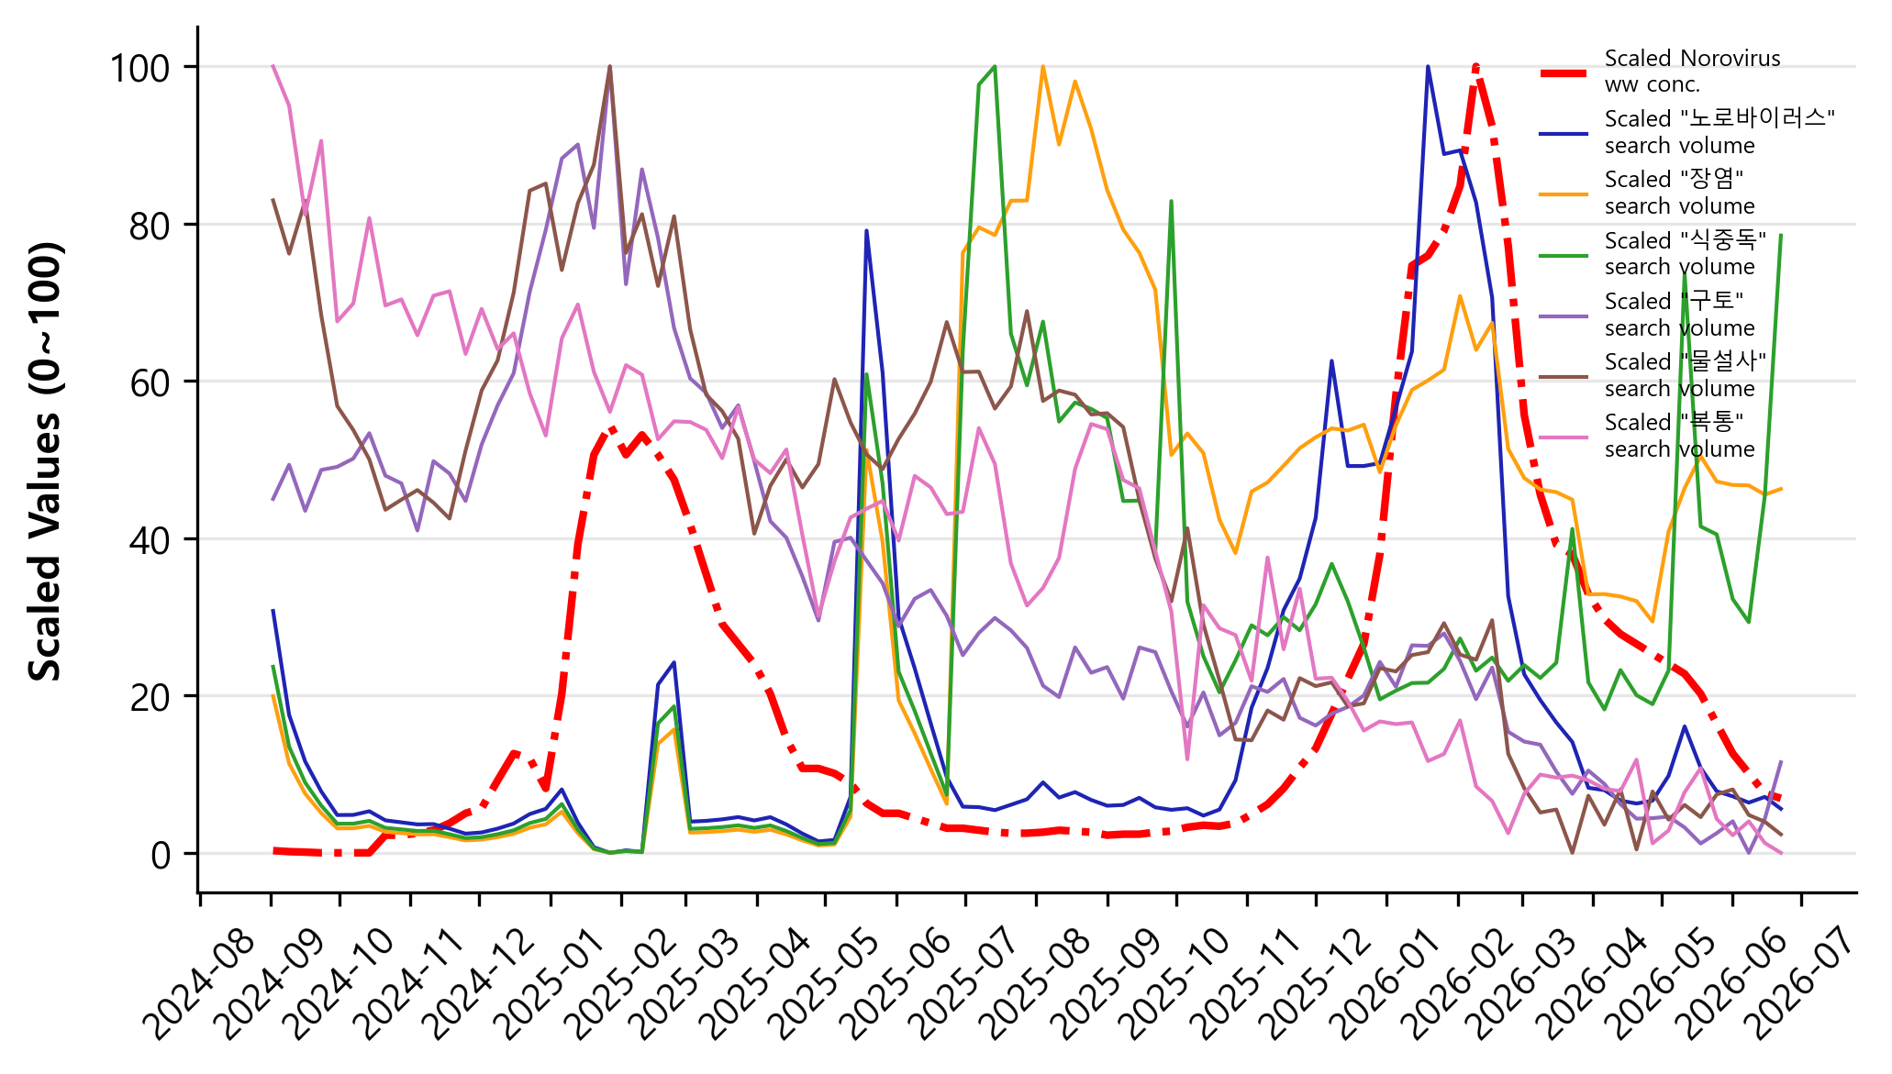
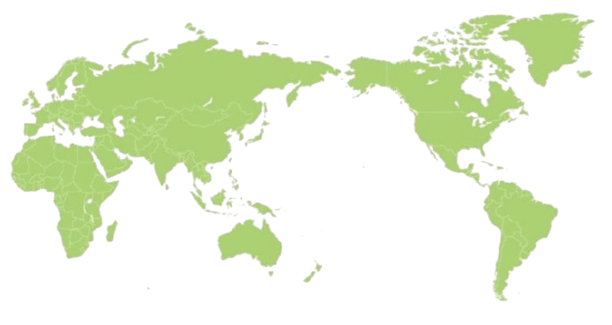
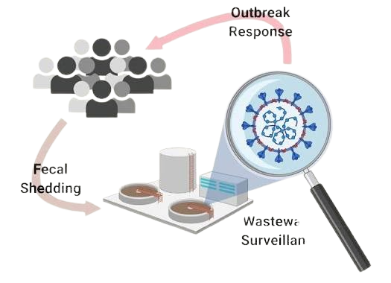
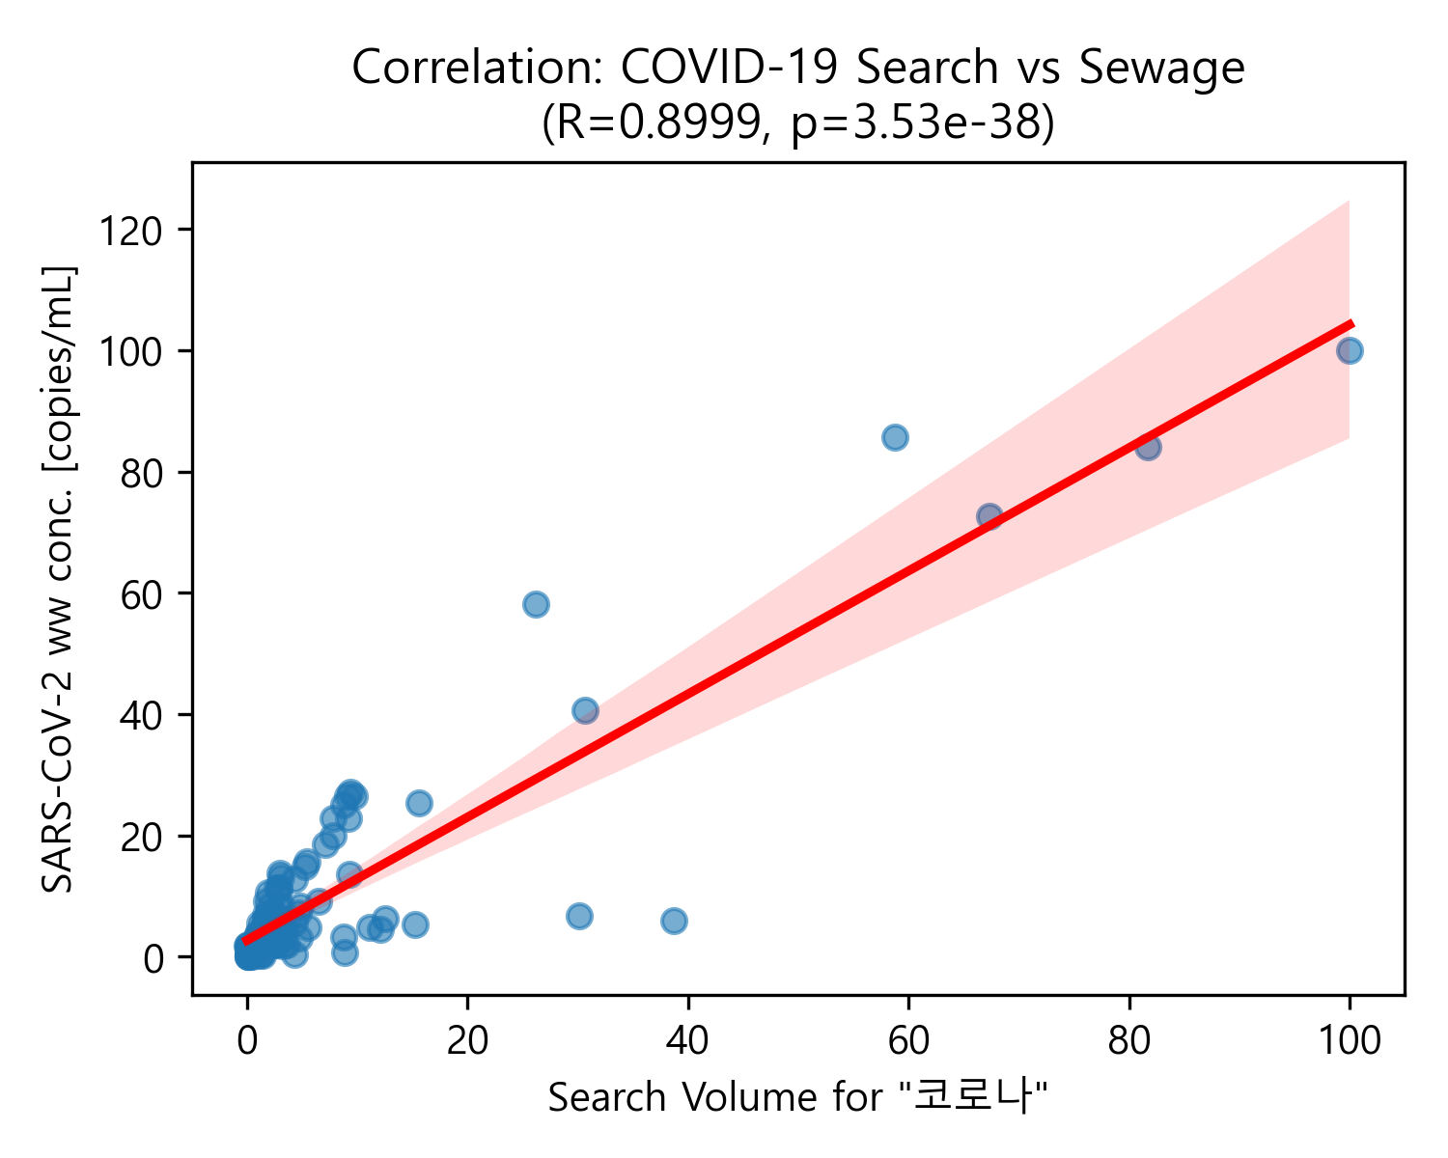
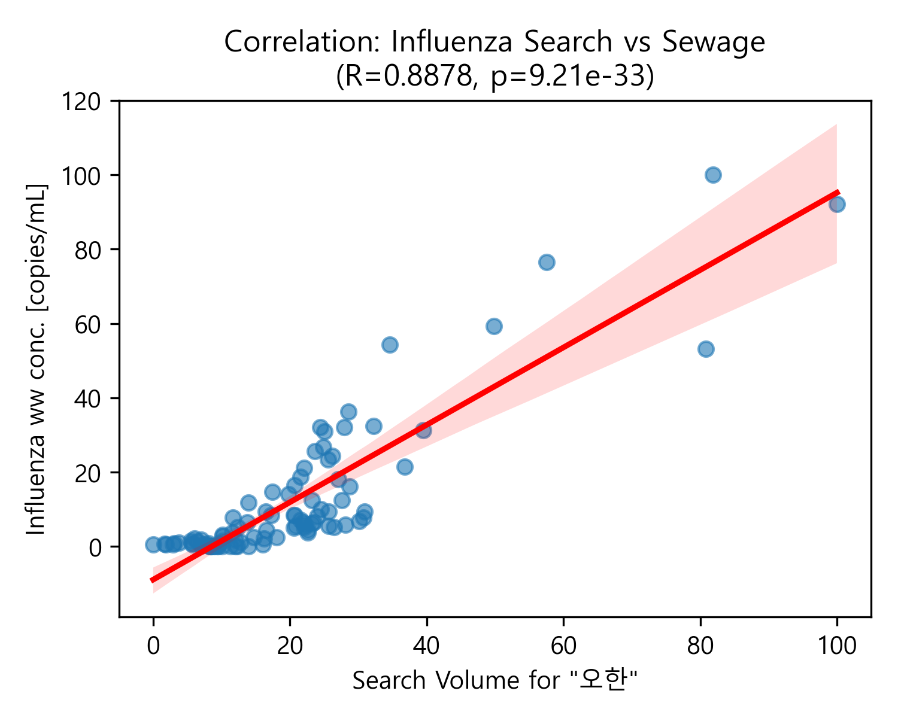
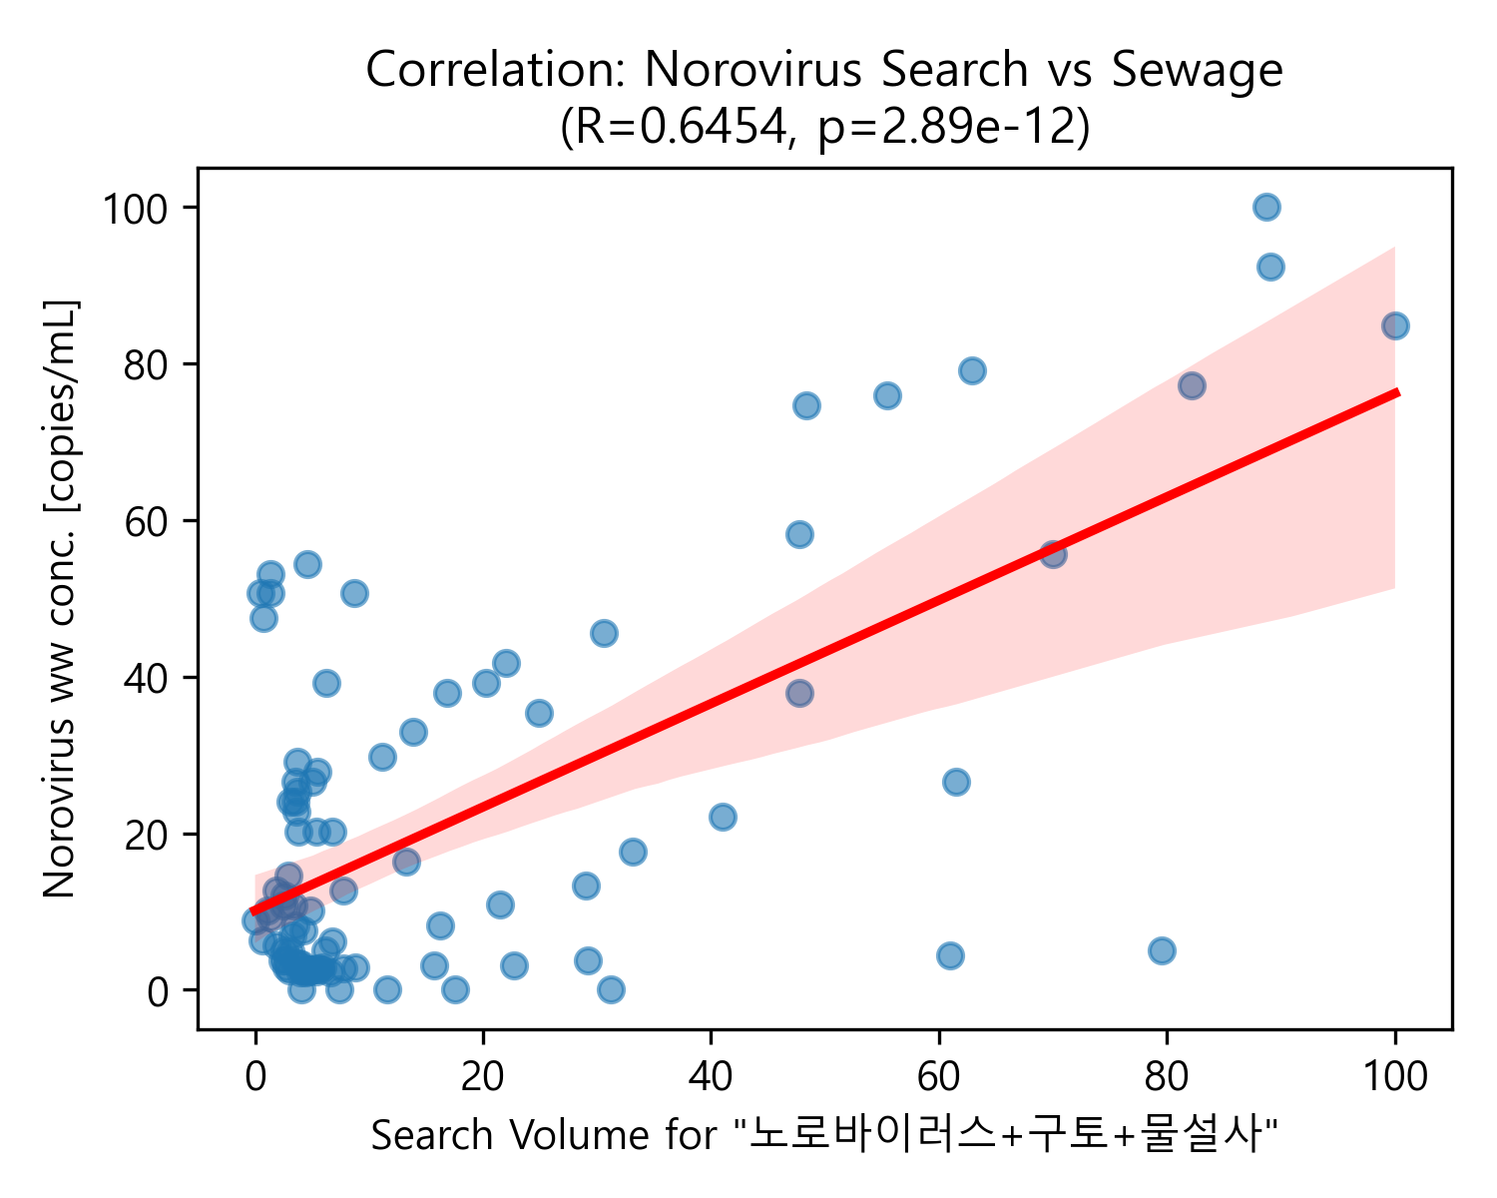
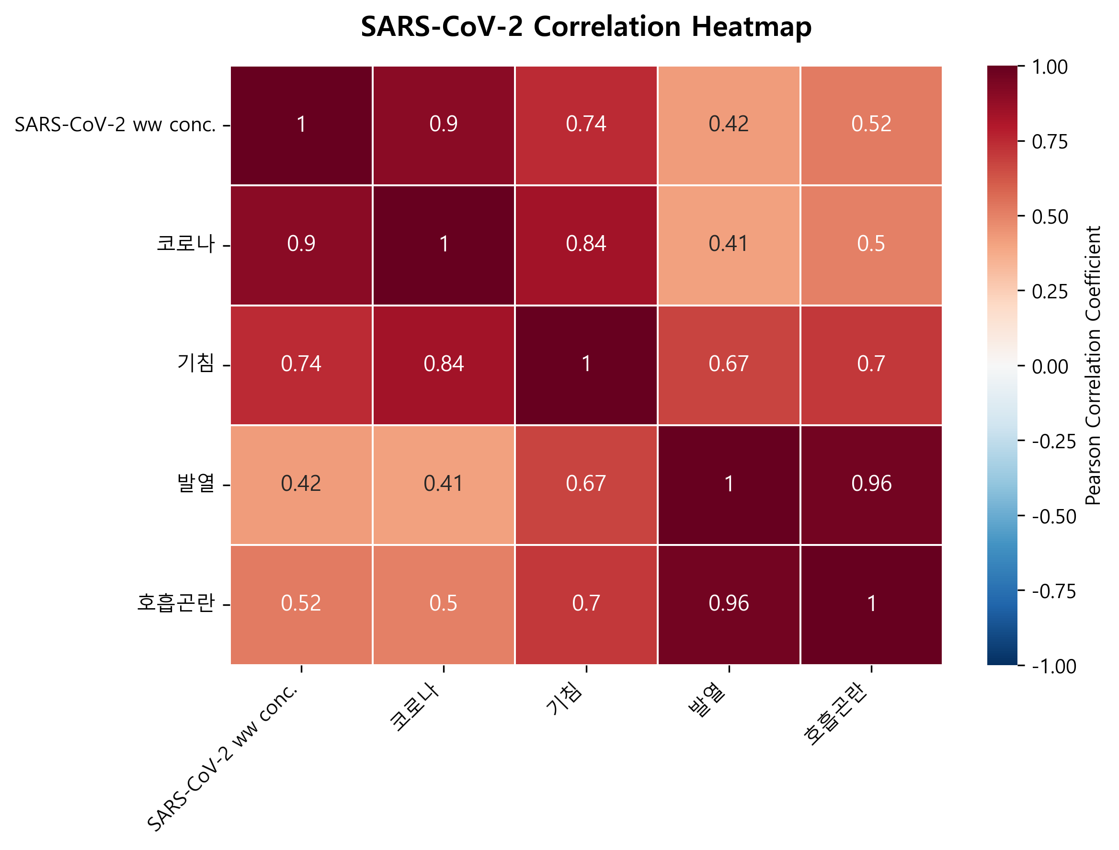
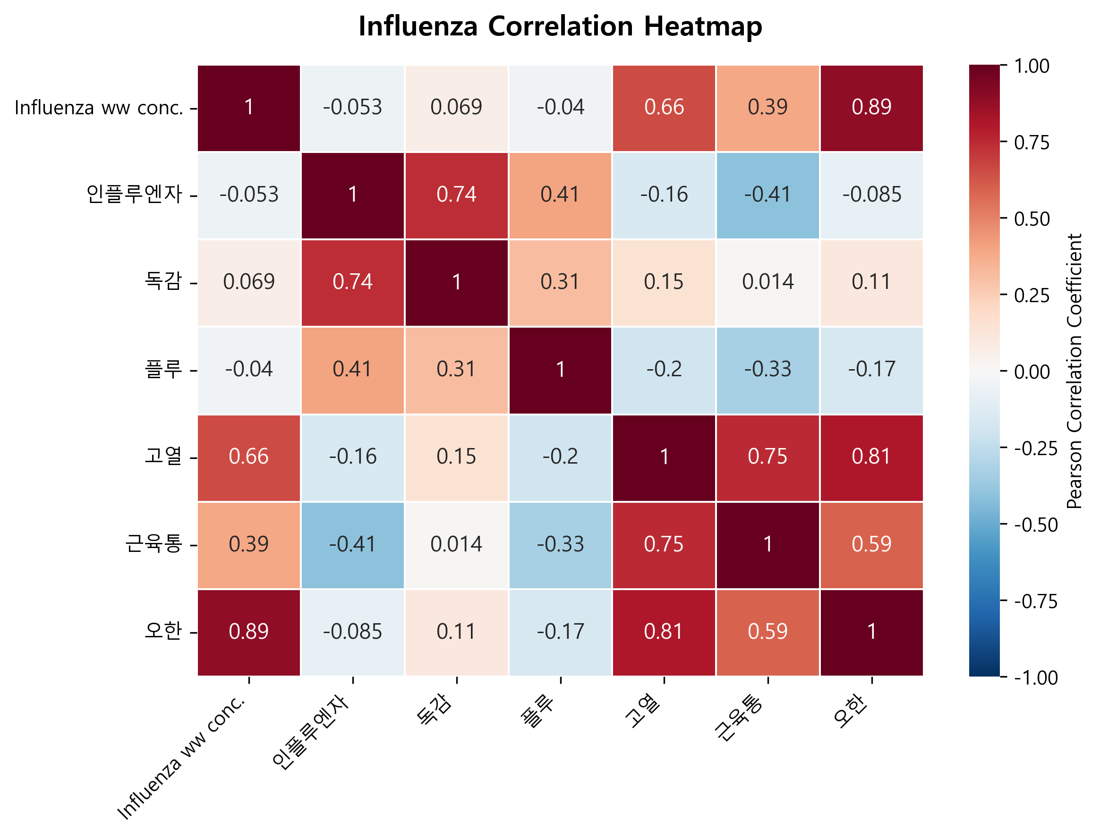


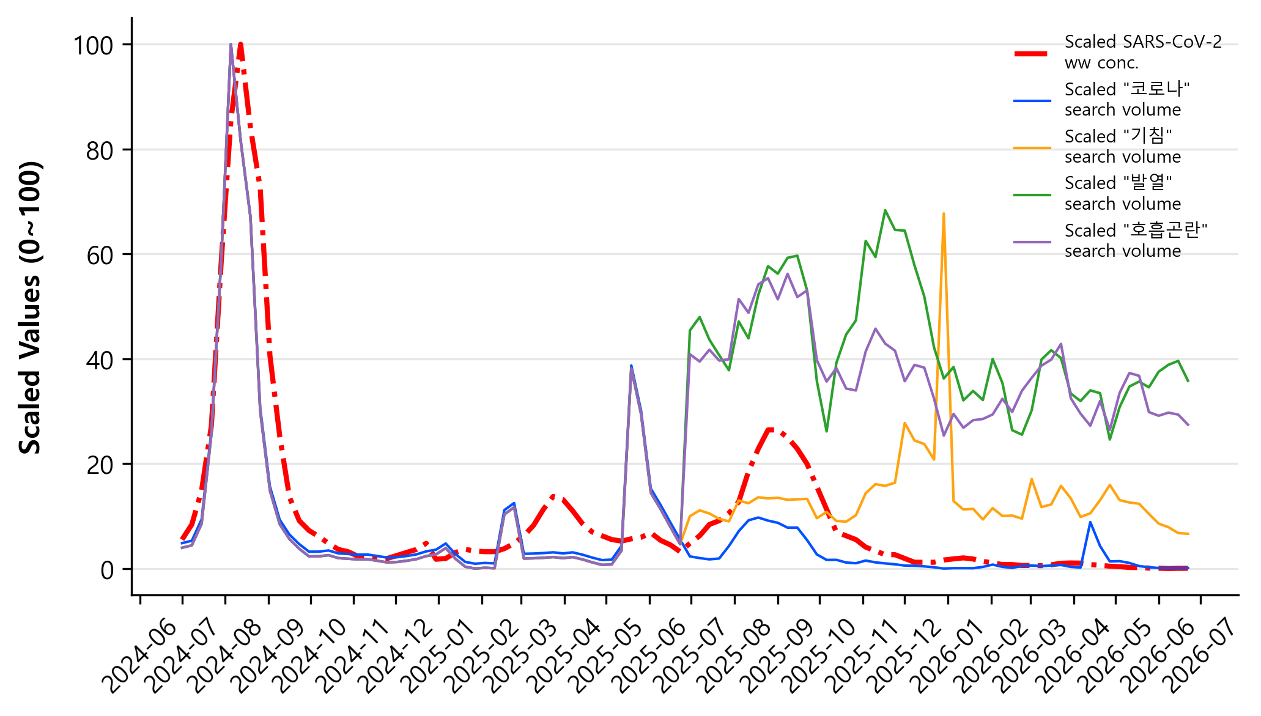
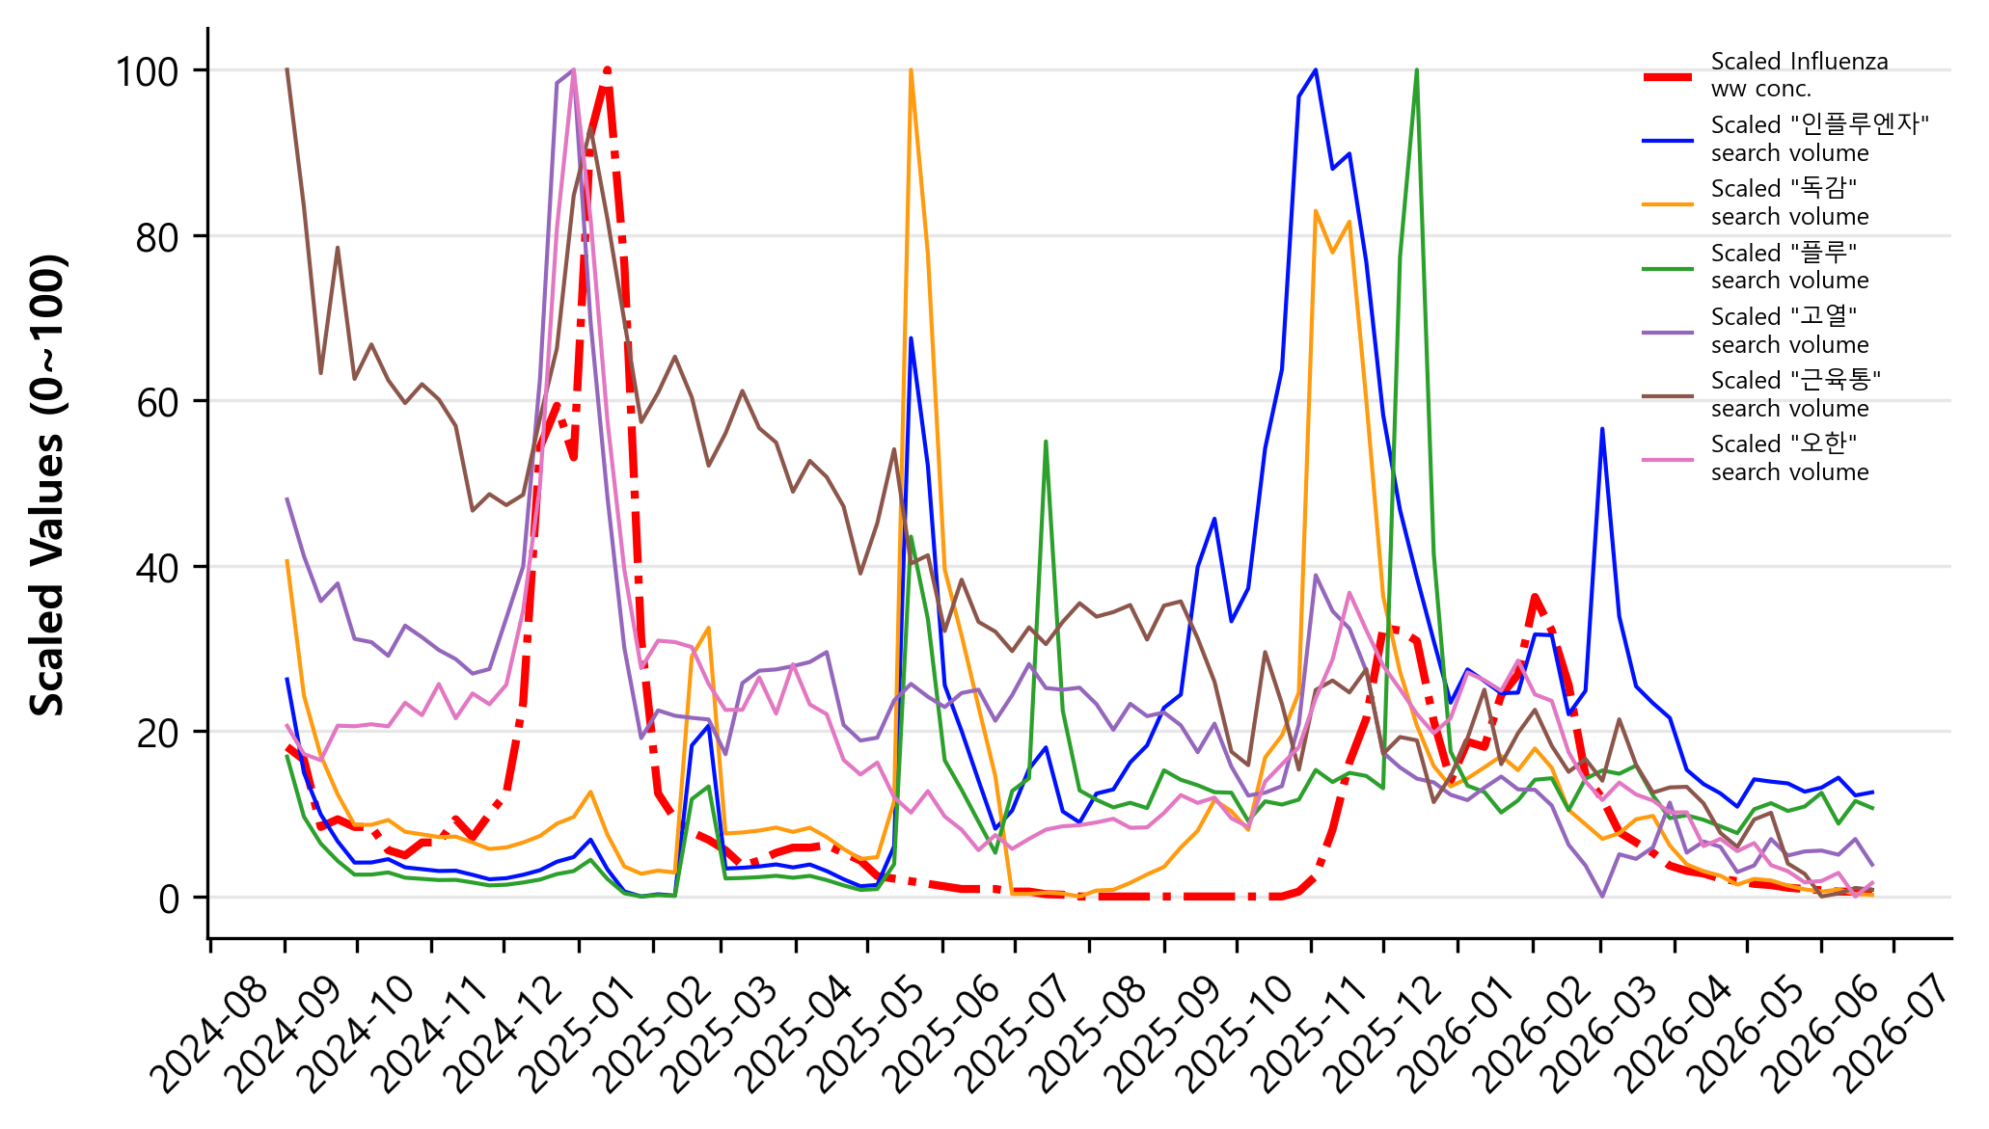

EpiSearch: Identifying Disease-Specific Leading Search Indicators
Using Wastewater Surveillance Data in Korea
${\text{Seo}\text{−}\text{Jin} \text{Kang}}^{1}$, ${\text{Seongchan} \text{Kim}}^{2,3∗}$
¹ Sungkyul University, ² KISTI, ³ UST-KISTI
kseojin0205@sungkyul.ac.kr, sckim@kisti.re.kr
Motivation
  The risk of viral infection is strongly associated with the proportion of infected individuals in the community.
  Despite robust clinical testing infrastructure, clinical data remain limited.
  Wastewater-Based Epidemiology, the high cost associated with advanced technology.
  → not available in many parts of the world.
  Visualized the temporal trends of wastewater pathogen concentrations and keyword search volumes using graphs.
Results
  SARS-CoV-2 (r=0.9) and Influenza (r=0.89) serve as leading indicators for one week, while Norovirus (r=0.65) serves as leading indicators for two weeks.
  Statistically significant correlations were confirmed for all of them.
  Identified the optimal keywords with the highest correlation coefficients through heatmap analysis.
High Cost
Internet Search Behavior
  When people are exposed to an infectious disease, they tend
  to search for information about the disease and its symptoms.
  Keywords by Target Infectious Diseases
  SARS-CoV-2: 코로나, 기침, 발열, 호흡곤란
  Influenza: 인플루엔자, 독감, 플루, 고열, 근육통, 오한
  Norovirus: 노로바이러스, 장염, 식중독, 구토, 물설사, 복통
  Search Term Combination Strategies
  Single Keywords
  Disease Name & Symptom Keyword Group
  Keyword Combination
  Temporal Pearson Correlation
  Temporal Correlation Analysis with WBE (Wastewater-Based Epidemiology) Pathogen Concentration Data.
  Time-Lag Analysis (Up to 3 Weeks)
  By shifting the web search data and wastewater concentration data, respectively, and applying a time-delay correlation analysis, we identify the causal relationship.
Conclusion
  The Need for Disease-Specific Strategies
  It has been confirmed that web search term composition strategies and lead times vary depending on the type of infectious disease.
  Proactive Decision Support via Early Warning Indicators
  By overcoming the time-lag of WBE and clinical surveillance, validated web search combinations act as powerful early warning indicators. This approach is expected to serve as a crucial decision-support tool for the KDCA to optimize proactive responses and resource allocation.
 | $$r_{xy}=\frac{\sum_{t=1}^{n}{(X_{t}−\overline{X})(Y_{t}−\overline{Y})}}{\sqrt{\sum_{t=1}^{n}{{(X_{t}−\overline{X})}^{2}}}\sqrt{\sum_{t=1}^{n}{{(Y_{t}−\overline{Y})}^{2}}}}$$ | (1)
Data
  Concentrations of Infectious Diseases in Sewage from Korea Disease Control and Prevention Agency (KDCA) Portal.
  Search Volumes for Keyword by Infectious Diseases from NAVER Ads and NAVER Datalab.
  Min-max normalization from 0 to 100 is performed.
  Period: SARS-CoV-2 (Jul. 2024 – Jun. 2026) |
  Influenza &Norovirus (Sep. 2024 – Jun 2026)
Future Works
  Expanded Variables & Scope Expansion
  Enhancing the framework by incorporating diverse socio-environmental variables (e.g., meteorological data, population mobility) and expanding the scope to emerging infectious diseases with detailed city/provincial-level analyses.
  Predictive Model & Early Warning System
  Developing a real-time infectious disease monitoring Agentic
  AI to support proactive decision-making by public health authorities.
Acknowledgments This research was supported by the Korea Institute of Science and Technology Information (KISTI) [Project No. K26L8M2C1, Development of AI-based Early Warning System for Infectious Disease Using Wastewater].

